Slide 1

MAHATMA GANDHI INSTITUTE OF TECHNOLOGY(A)
DEPARTMENT OF INFORMATION TECHNOLOGY
An Industry Oriented Mini Project(IT653PC)
On
Identifying Disease for Liver CT-Scan Images
By
Rajdeep Bhavanarushi(22261A1210)
Sudarshan Reddy(22261A1244) Batch ID: IT-25-25
IOMP Supervisor
Mrs.U.Chaitanya
Assistant Professor
Internal Supervisor :
Mrs. A.V.L. Prasuna

Slide 2
OUTLINE
ABSTRACT
INTRODUCTION
EXISTING SYSTEM
PROPOSED SYSTEM
APPLICATIONS
REQUIREMENTS
LITERATURE SURVERY
PROBLEM STATEMENT
OBJECTIVES
MODULES DESCRIPTION
ALGORITHM
DESIGN
CODE EXECUTION / RESULT
TEST CASES
CONCLUSION AND FUTURE ENHANCEMENT
REFERENCES

Slide 3
ABSTRACT
Liver diseases, such as cirrhosis, Carcinoma, and liver cancer, pose a serious global health challenge, contributing significantly to morbidity and mortality. Early and accurate diagnosis is essential for effective treatment and better patient outcomes. This project focuses on a predictive analysis approach for liver disease diagnosis using medical imaging.
By allowing users to upload liver scan images, the system utilizes a trained deep learning model to analyze and classify the images for potential liver abnormalities. This streamlined image-based prediction method offers a fast and accessible diagnostic tool, aiming to support early detection efforts. The project also highlights the benefits, limitations, and future scope of using image-driven predictive analysis in improving liver disease screening and healthcare delivery.

Slide 4
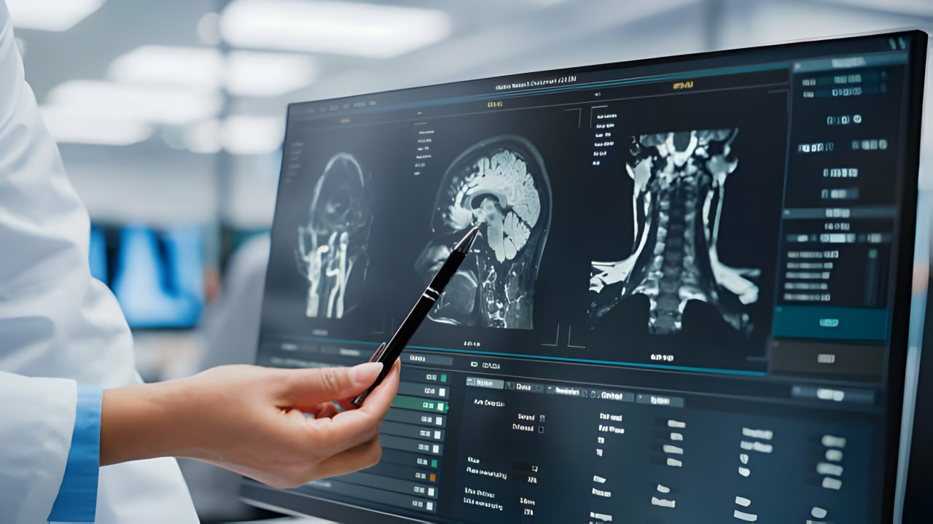
INTRODUCTION
Liver diseases, including Carcinoma, Squares cell Carcinoma, and hepatocellular carcinoma, represent a growing global health concern due to their increasing prevalence and often silent progression. Early detection of these conditions is crucial, as timely intervention can significantly improve patient outcomes and reduce the burden on healthcare systems. However, traditional diagnostic methods often require specialized medical expertise and equipment, which may not be accessible to all.
In response to this challenge, this project presents a predictive analysis system designed specifically for liver disease detection using medical imaging. The system enables users to upload liver scan images, which are analyzed through a trained deep learning model ( VGG 16) to predict the presence or absence of liver abnormalities.

Slide 5
EXISTING SYSTEM
Manual Checking – Diagnosis is primarily based on physician observation, which can be subjective and may miss early-stage symptoms.
Latestage Detection–Diseases are often diagnosed only after noticeable symptoms emerge, reducing the chances of successful intervention.
Inconsistent AI Usage –AI tools are not widely or uniformly adopted in hospitals, limiting their impact on routine diagnostics..
Isolated Data Systems- Medical data such as imaging, EHRs, and lab results are not fully integrated, making it hard to draw accurate conclusions or apply predictive analytics..

Slide 6
PROPOSED SYSTEM
Reduce Errors– Aims to reduce human error, speed up diagnosis, and improve patient outcomes, .
No External Expert Dependency– The system works autonomously without requiring a radiologist for verification, offering instant preliminary analysis.
Simple and Intuitive User Interface– The web application is designed for ease of use, allowing non-technical users to upload and interpret results quickly.
Label Output with Confidence Score: The system returns a prediction label along with a confidence percentage to indicate the model’s certainty.

Slide 7
Applications
Liver Oncology –Early detection of liver tumors such as hepatocellular carcinoma from CT-scans.
Liver Disease Screening – Classification of conditions like Carcinoma, Squaress Cell Carcinoma, based on the CT-image input for liver .
Predictive Risk Assessment – Estimating the likelihood of liver abnormalities for proactive health management.

Slide 8
Hardware and software specifications
Software
Hardware
Py-torch
Scikit-learn
Hugging Face Transformers
Flask API
Mongo DB
HTML
Bootstrap Framework CSS
JavaScript
NVIDIA RTX 3080
Intel core i7/i9
Minimum 64 GB (RAM)

Slide 9
Literature survey
SNO | AUTHOR NAMES, YEAR OF PUBLICATION | JOURNAL OR CONFERENCE NAME AND PUBLISHER | METHODOLOGY / ALGORITHM / TECHNIQUES USED | MERITS | DEMERITS | RESEARCH GAPS
1 | Jingshu Liu, Zachariah Zhang, Narges Razavian (2018) | Proceedings of the Machine Learning for Healthcare Conference (MLHC 2018), published on arXiv.org (Cornell University Library, open-access) | Proposed a deep multi-task learning model using CNNs and LSTMs for predicting multiple chronic diseases from EHRs, using both structured and unstructured clinical data. | Provides improved multi-disease detection accuracy, handles both time-series and text data efficiently | Needs massive computational power and clean datasets; complex to implement in smaller clinics. | Does not include medical imaging or radiological data in prediction models.
2 | Elhoseny M., Shankar K., Uthayakumar J. (2019) | Scientific Reports, a Nature Portfolio Journal (published by Springer Nature, open-access) | Hybrid machine learning model combining Support Vector Machines (SVM) and Genetic Algorithms (GA) to predict Chronic Kidney | Delivers high diagnostic accuracy with optimized features, lowering model complexity. | Only specific to kidney disease; lacks adaptability to other chronic conditions. | No use of radiological images or AI integration in medical imaging tools.
3 | Shishir Rao, Brett K. Beaulieu-Jones, et al. (2021) | Proceedings of the ACM Conference on Health, Inference, and Learning (ACM CHIL 2021), published on arXiv.org and ACM Digital Library | Uses Transformer-based deep neural networks with attention mechanisms to forecast heart failure from longitudinal EHR data. | Interpretability allows physicians to understand model decisions; enhances clinical collaboration. | High hardware dependency; training time is longer compared to classical models. | Focus is limited to cardiovascular diseases; lacks cross-domain applicability with radiology integration.
4 | Junaid Rashid, Hafeez Anwar, et al. (2022) | Frontiers in Public Health, section of Frontiers Media SA (indexed in Scopus and PubMed) | Designed a hybrid model using Artificial Neural Networks (ANN) | Efficient feature optimization and model convergence; suitable for large-scale datasets. | Model accuracy decreases with noisy/incomplete data; not suitable for real-time deployment yet. | No support for imaging data; lacks compatibility with radiology software or smart hospital systems.
5 | Raza Nowrozy, Adnan Masood, et al. (2023) | Journal of Biomedical Research & Environmental Sciences (JBRES), | Comparative analysis of ML algorithms (Random Forest, Logistic Regression. | Gives a clear benchmark of algorithm strengths and weaknesses. | Does not propose a unified or automated pipeline; | No use of imaging data, and limited focus on integration with AI-tool

Slide 10
PROBLEM STATEMENT
Liver diseases, including conditions such as cirrhosis and hepatocellular carcinoma, pose a significant health threat globally due to their often asymptomatic nature in early stages and high mortality rates when detected late. Traditional diagnostic approaches rely heavily on manual examination of CT scans, which is time-consuming, subject to human error, and dependent on radiologist expertise. With the increasing availability of liver imaging data, there's a growing need for automated systems that can assist in early detection and classification.
This project addresses the gap by implementing a Visual Transformer-based predictive analysis system specifically designed for liver CT scan interpretation, aiming to enhance diagnostic accuracy, accelerate analysis, and support early clinical decision-making in liver disease management..

Slide 11
OBJECTIVES
Implement visual transformer architecture tailored for liver ct scan image classification to explore its efficiency over traditional CNN-based models..
Establish a clean image preprocessing pipeline, ensuring high-quality liver scan data for optimal model performance.
Analyze model performance metrics like accuracy, precision, and recall to evaluate the effectiveness of visual transformers in liver disease detection.
Benchmark vit against baseline models (like vgg16 or resnet) to justify the selection of transformer-based architecture in radiological prediction tasks.
Minimize false positives and false negatives in liver disease prediction by fine-tuning model hyperparameters and data augmentation techniques..

Slide 12
MODULES
Medical Imaging Input Module:
This module handles the upload and preprocessing of the liver CT-Scan from the user, ensuring that they correctly resized for the liver
disease identification for the deep learning model.
Image Preprocessing Module:.
Prepares data for deep learning models by resizing, segmenting, or annotating images as needed.
Sklearn Metrics Module :
Evaluates model performance which demonstrates classification report such as confusion matrix, precision, recall,f1-score .
Web Interface Module (using Flask) :
The Flask application in pycharm IDE helps in creating the backend and helps to upload the image given to the webpage

Slide 13
ALGORITHM
Step 1: Start the System
Initialize all core components
Step 2: Data Acquisition
Radiology Image Collection
Step 3: Preprocessing of Data
Image Data Preprocessing
Step 4: Feature Integration
Step 5: Risk Detection & Prediction
Run data through ML Models
Step 6: Output Generation
Step 7: End Process

Slide 14
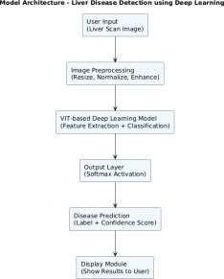
ARCHITECTURE

Slide 15
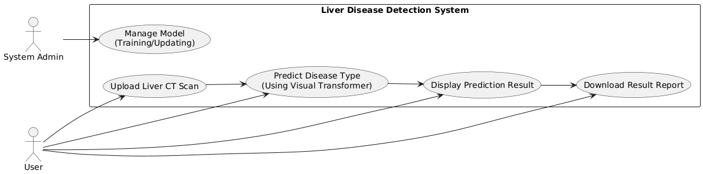
USE CASE DIAGRAM

Slide 16
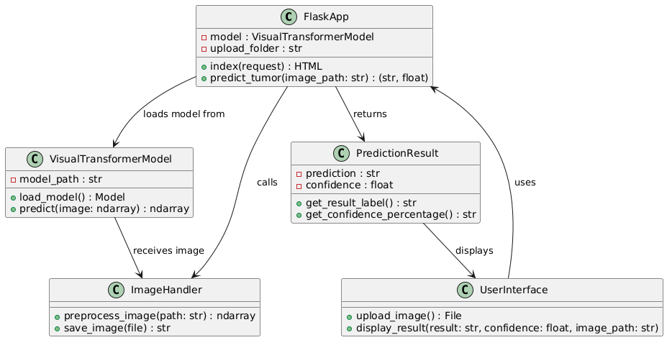
CLASS DIAGRAM

Slide 17
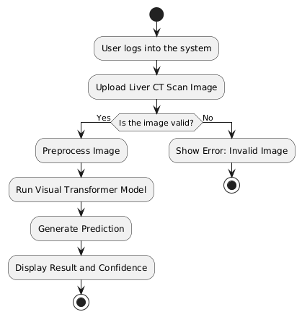
ACTIVITY DIAGRAM

Slide 18
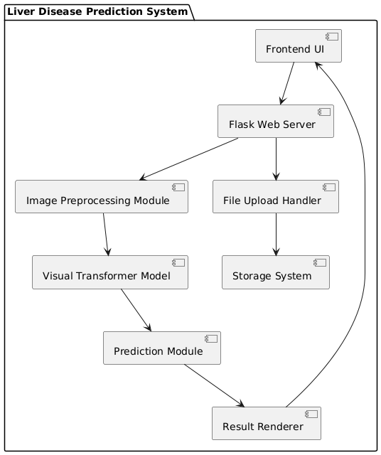
COMPONENT DIAGRAM

Slide 19
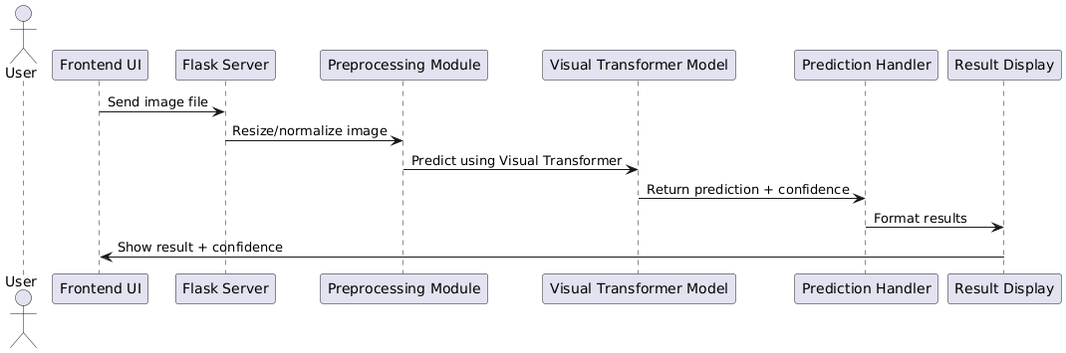
SEQUENCE DIAGRAM

Slide 20
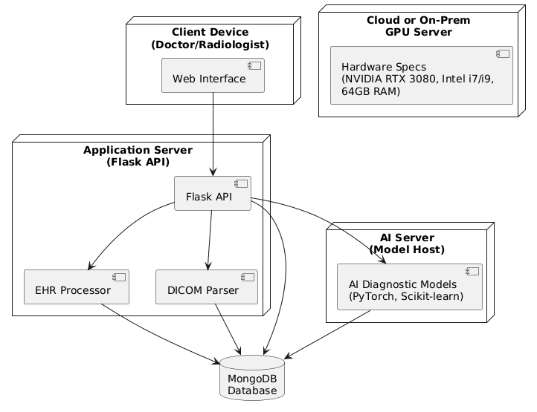
DEPLOYMENT DIAGRAM

Slide 21
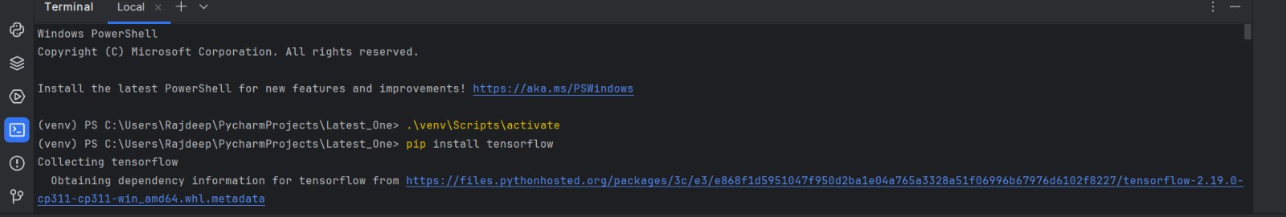
CODE IMPLEMENTATION AND OUTPTS:

Slide 22
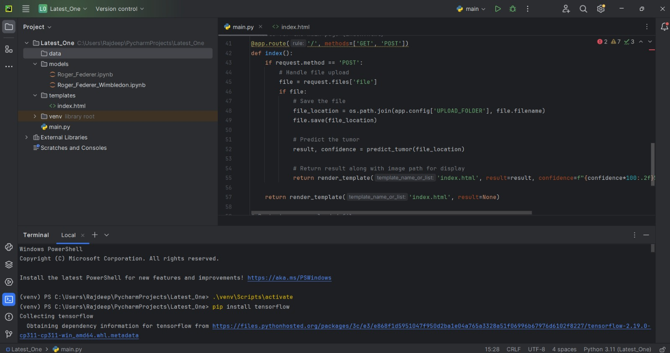

Slide 23
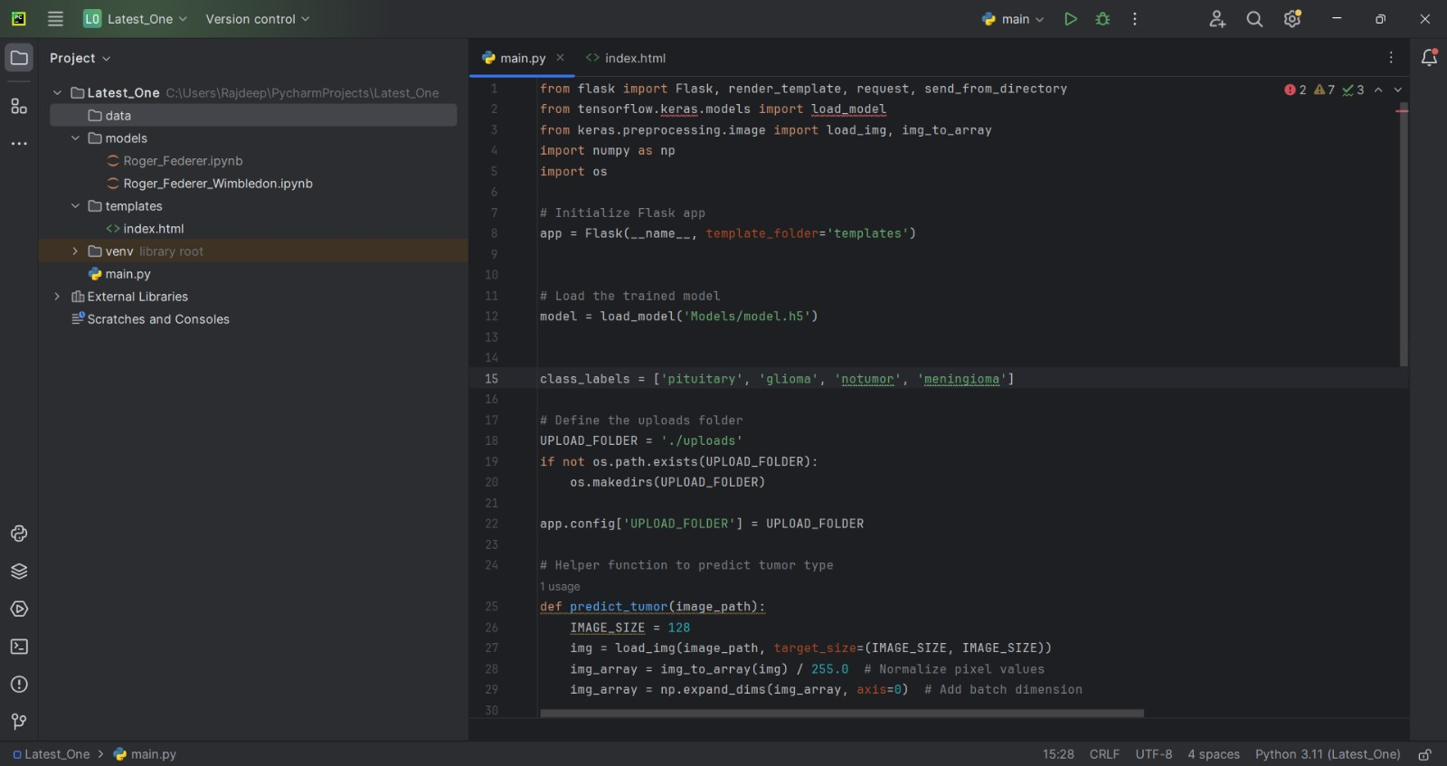

Slide 24
TEST CASES
S. No | Test Case Name | Input | Expected Output | Actual Output | Remarks
1 | Submit Liver Image Data | Liver CT scan image | Image saved and passed to diagnostic prediction engine | Image saved and passed to diagnostic prediction engine | Pass
2 | Trigger Disease Prediction | CT scan image + metadata | Displays liver condition prediction with probability score | Displays liver condition prediction with probability score | Pass
3 | View Diagnostic Heatmap | None | Heatmap overlay showing affected regions on the liver image | Heatmap overlay showing affected regions on the liver image | Pass
4 | Recommendation Trigger | Prediction result = High Risk | Displays specialist recommendation and next steps | Displays specialist recommendation and next steps | Pass
5 | Suggest Tips for Liver Care | Mild fatty liver | Shows dietary, lifestyle and medical tips | Shows dietary, lifestyle and medical tips | Pass
6 | Access Diagnostic Summary | None | Redirects to /summary page and displays full report | Redirects to /summary page and displays full report | Pass

Slide 25
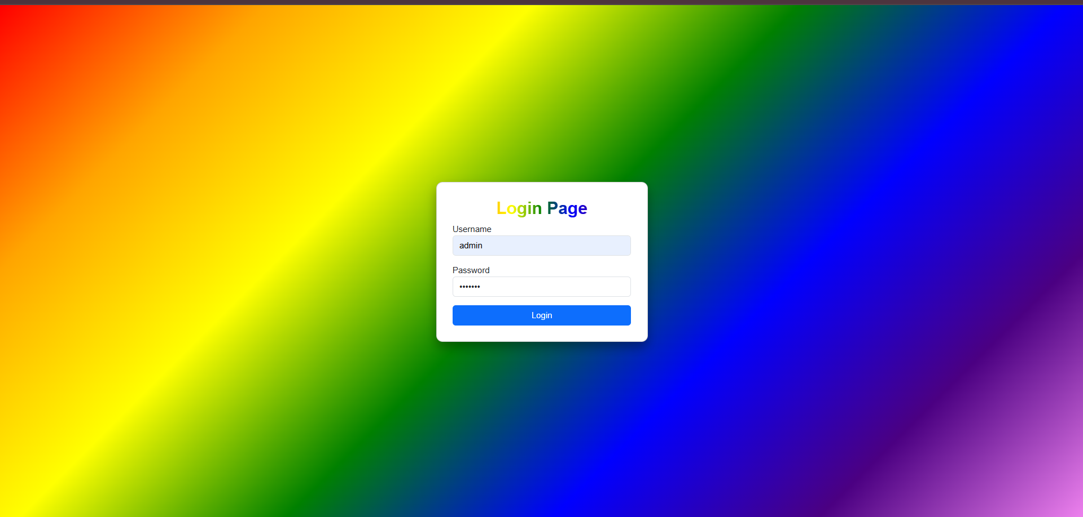

Slide 26
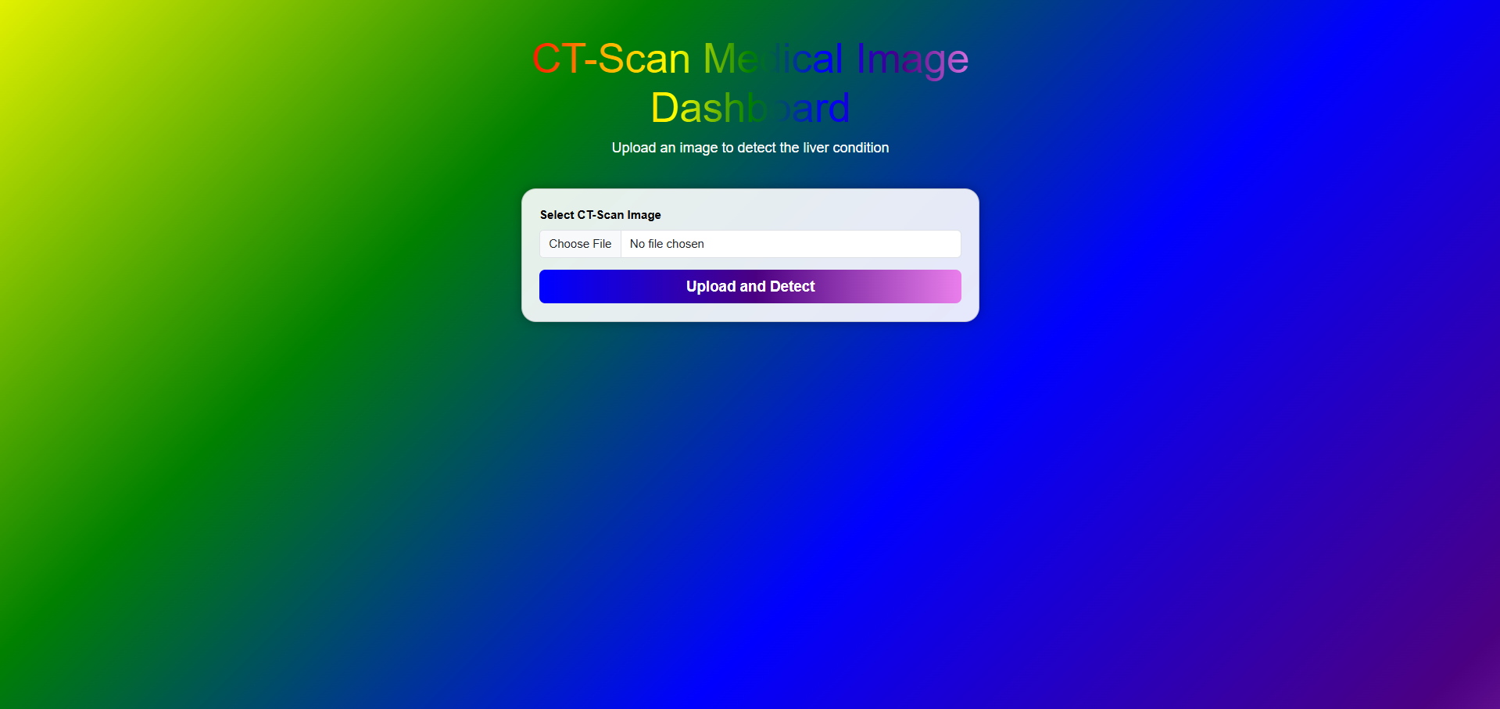

Slide 27
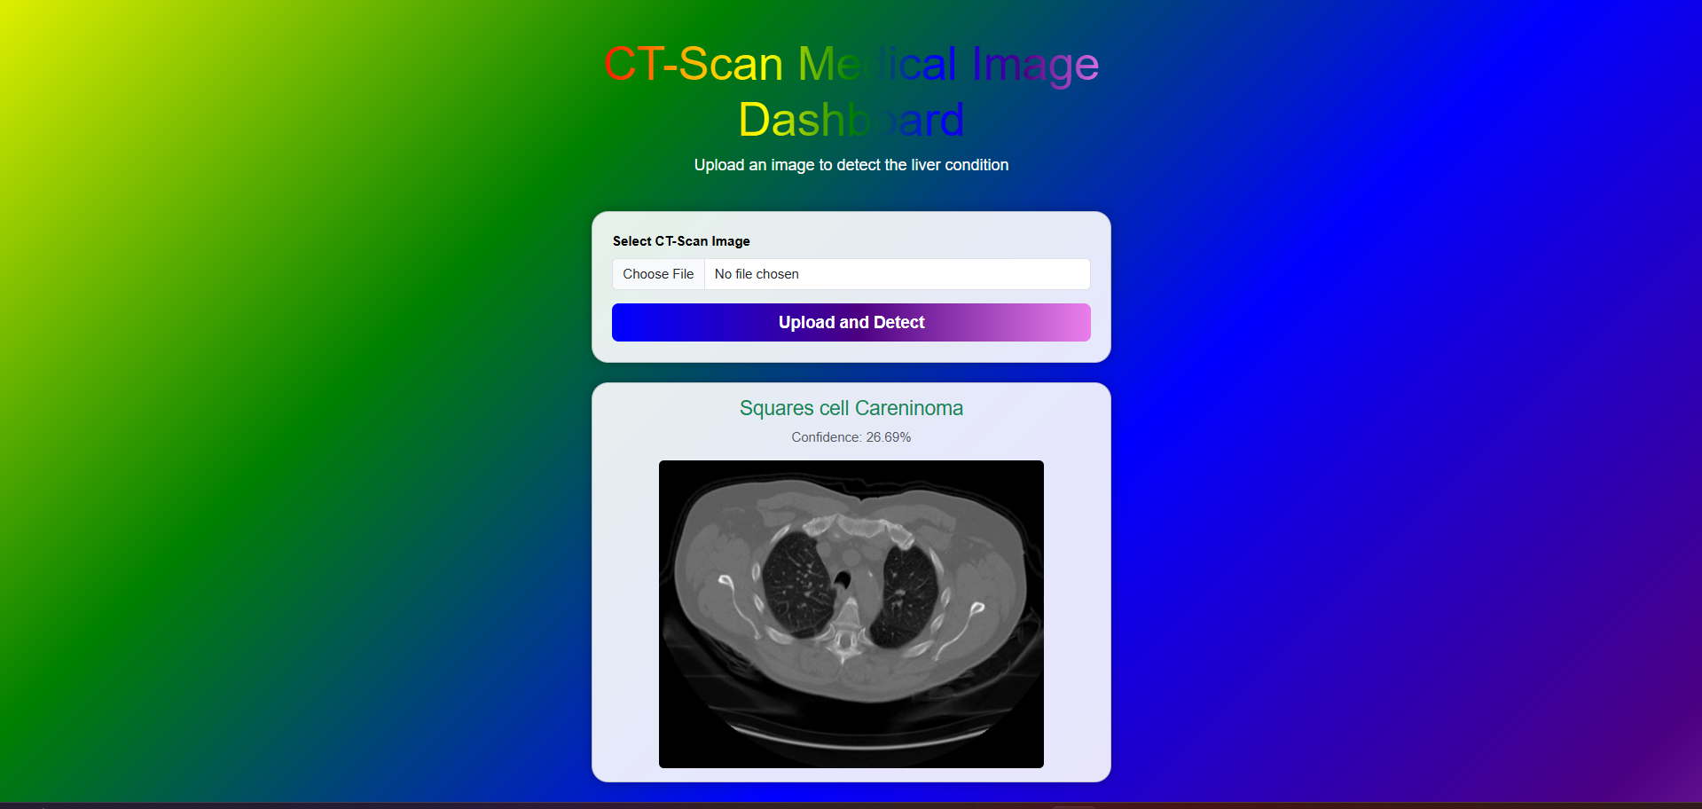

Slide 28
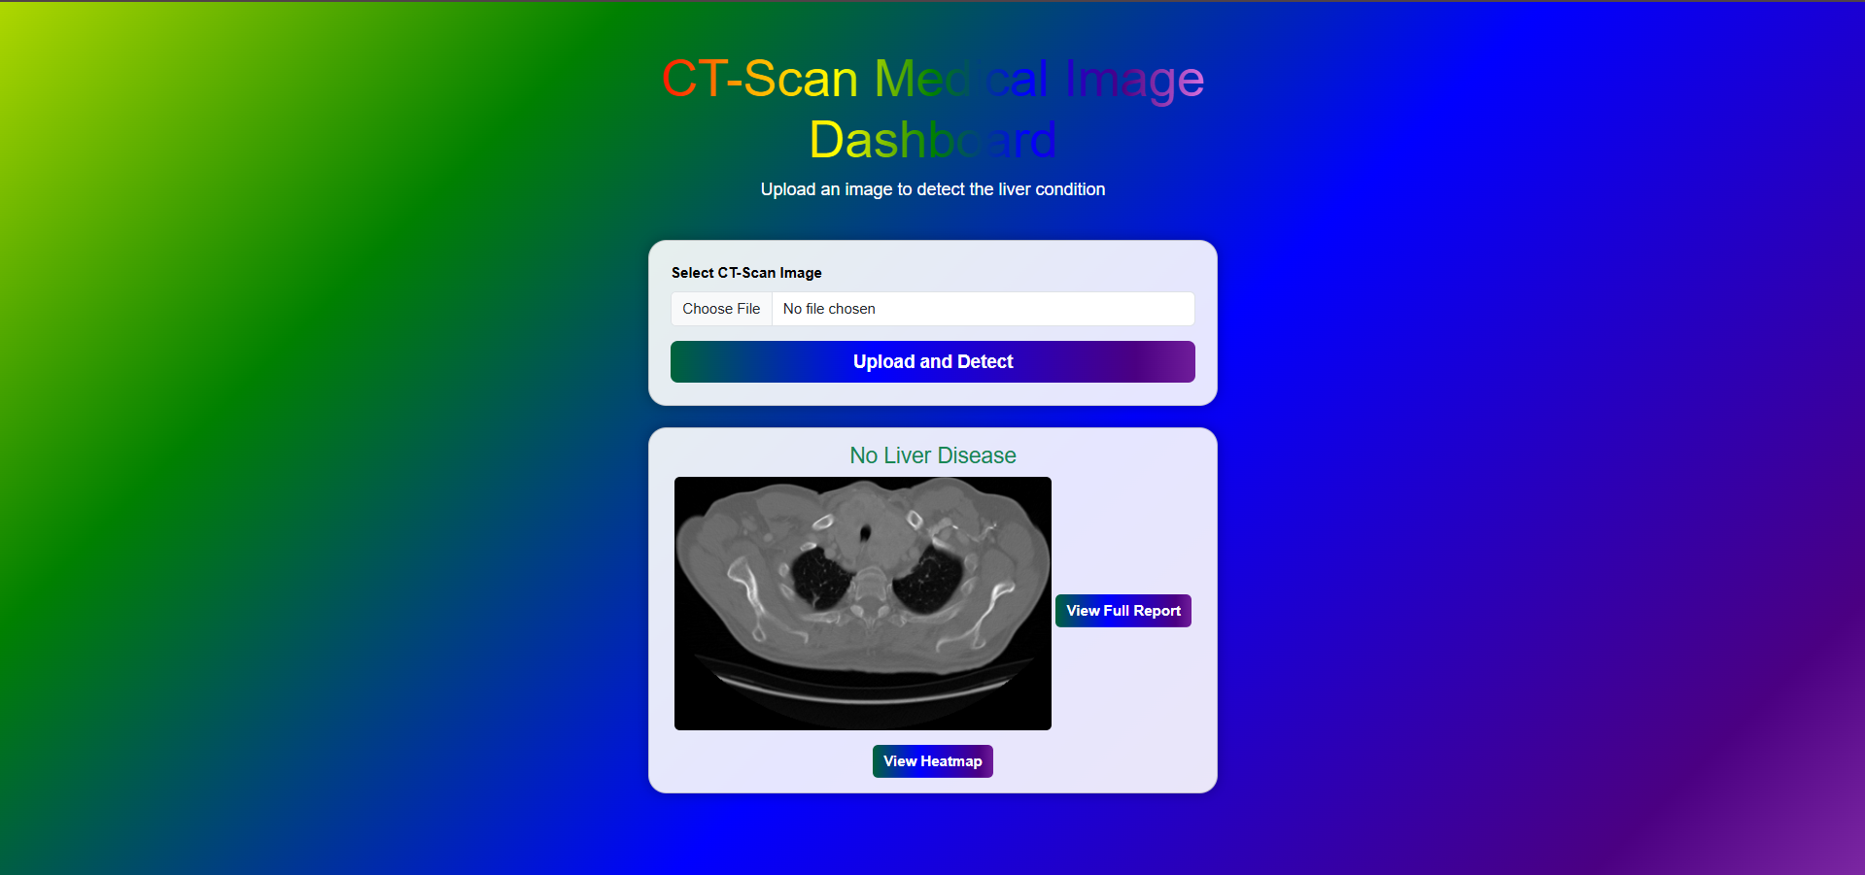

Slide 29
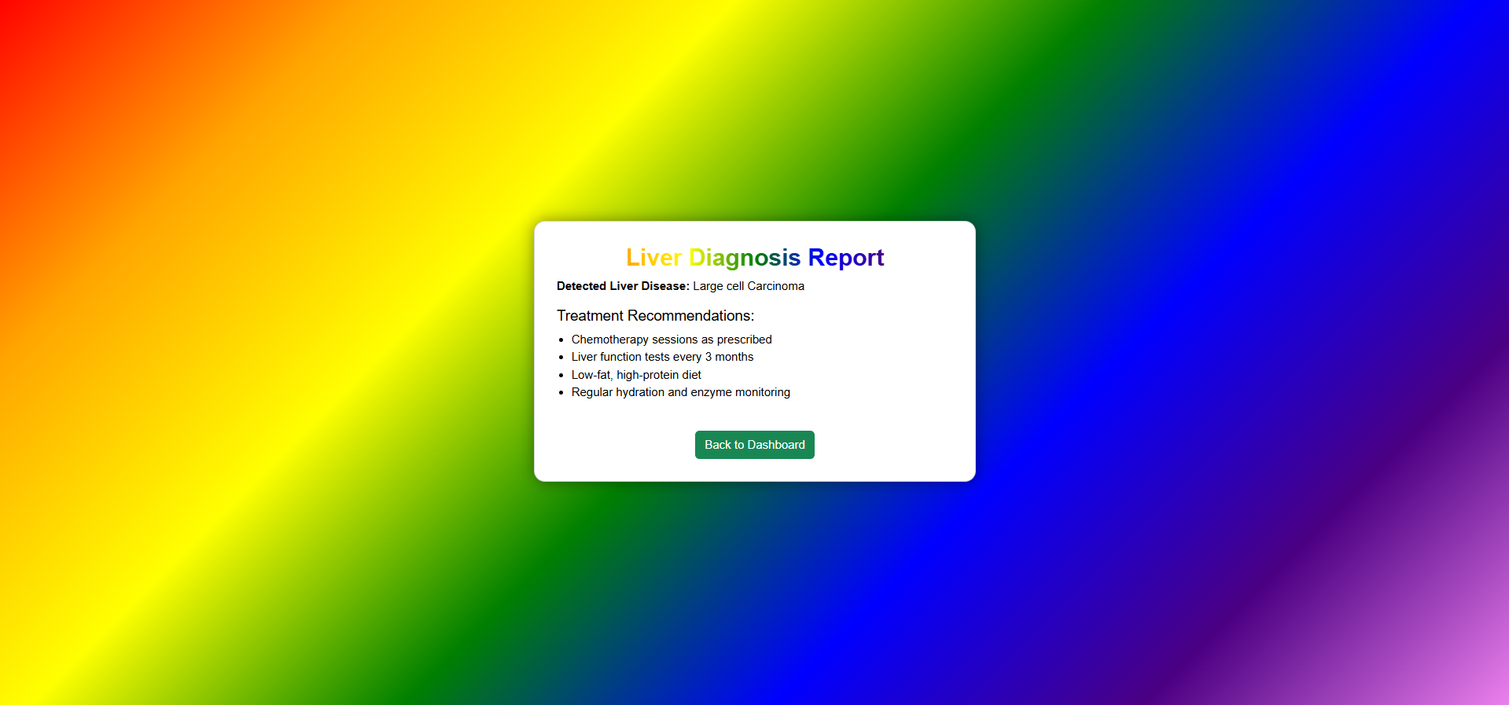

Slide 30
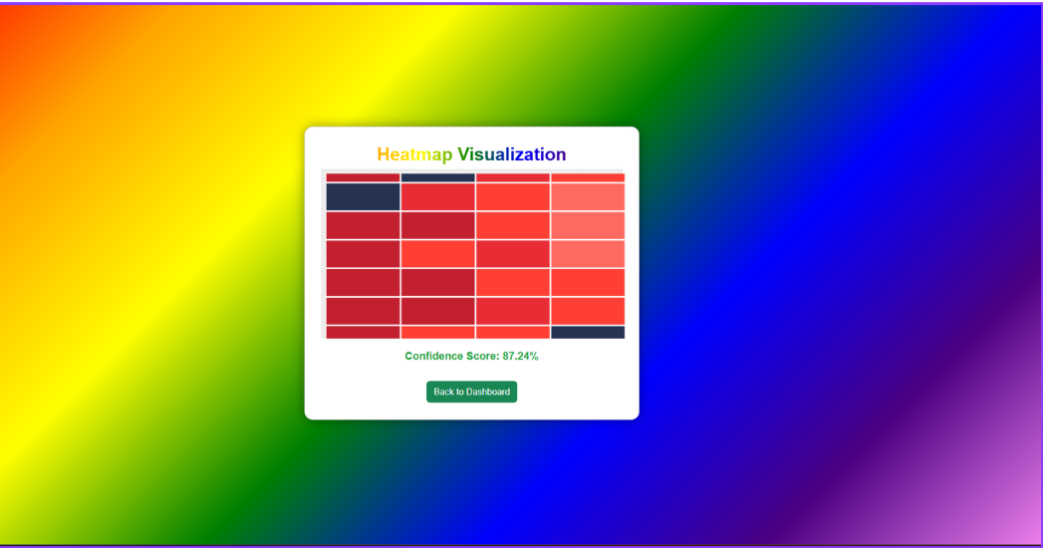

Slide 31
CONCLUSION AND FUTURE ENHANCEMENT
Conclusion:
This project demonstrates the effective use of Visual Transformer-based models for the early detection of liver diseases through CT scan analysis.
By leveraging Machine learning techniques, the system can accurately classify liver conditions, supporting users/Patients in identifying potential abnormalities more efficiently.
The model offers a simple , automated, and scalable solution that reduces diagnostic delays and enhances clinical decision-making in liver disease management.
Future Enhancement:
Include support for additional liver imaging modalities like MRI and ultrasound.
Integrate segmentation techniques to localize liver anomalies for more precise analysis.
Enhance the model’s robustness with a larger, more diverse dataset from multiple healthcare sources.
Collaborate with hospitals for clinical trials and real-world validation.
Implement multi-language support and telemedicine integration for rural and underserved areas.

Slide 32
REFERENCES
J. Liu, Z. Zhang, and N. Razavian, "Deep EHR: Chronic Disease Prediction Using CNN and LSTM Based Multi-task Learning," Proceedings of the Machine Learning for Healthcare Conference (MLHC 2018), arXiv.org (Cornell University Library), 2018, pp. 1–15, doi: 10.48550/arXiv.1808.04928.
M. Elhoseny, K. Shankar, and J. Uthayakumar, "Hybrid Machine Learning Model for Chronic Kidney Disease Prediction," Scientific Reports, Springer Nature, 2019, vol. 9, Article 17904, doi: 10.1038/s41598-019-46074-2.
S. Rao, B. K. Beaulieu-Jones, et al., "Forecasting Heart Failure with Transformers," Proceedings of the ACM Conference on Health, Inference, and Learning (CHIL 2021), ACM Digital Library, 2021, pp. 100–110, doi: 10.1145/3450439.3451874.
J. Rashid, H. Anwar, et al., "Disease Prediction Using ANN-PSO Hybrid Model Across Diverse Datasets," Frontiers in Public Health, Frontiers Media SA, 2022, vol. 10, Article 982734, doi: 10.3389/fpubh.2022.982734..
R. Nowrozy, A. Masood, et al., "Comparative Analysis of Machine Learning Algorithms for Chronic Disease Prediction," 2023 6th International Conference on Contemporary Computing and Informatics (IC3I), Mysuru, India, IEEE, 2023, pp. 367–372, doi: 10.1109/IC3I59073.2023.10373286..

Slide 33
THANK YOU

